Slide 1
Session 3
NAD1001: INTRODUCTION TO ARCHITECTURAL DESIGN

Slide 3
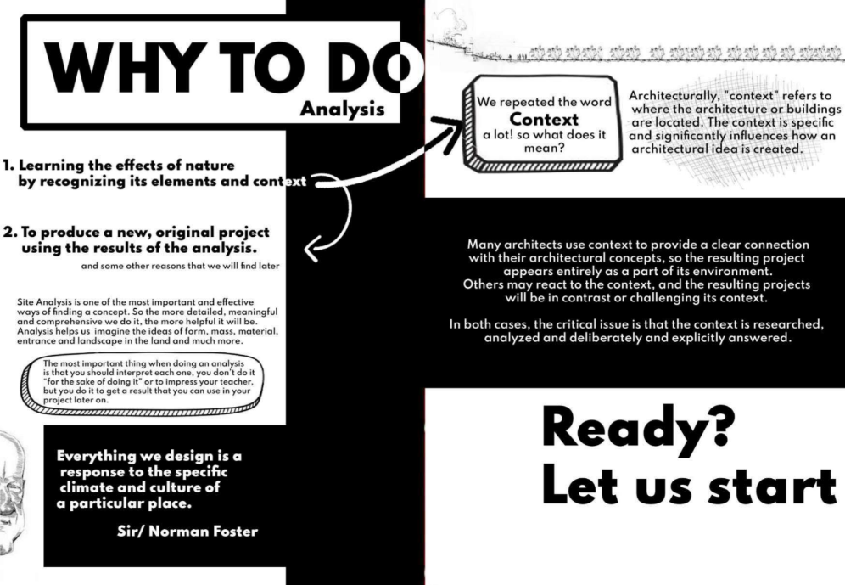
Introduction to Site Analysis
Site analysis in architectural design is the process of evaluating the physical, environmental, and regulatory characteristics of a site to inform and optimise design decisions
It aims to ensure compliance with legal constraints, maximise the site’s potential, and integrate the project sensitively into its context
Overall, site analysis is a foundational step in the architectural design process that ensures the proposed project is viable, contextually appropriate, and sustainable
https://www.archdaily.com/939530/site-analysis
Source: ArchDaily

Slide 4
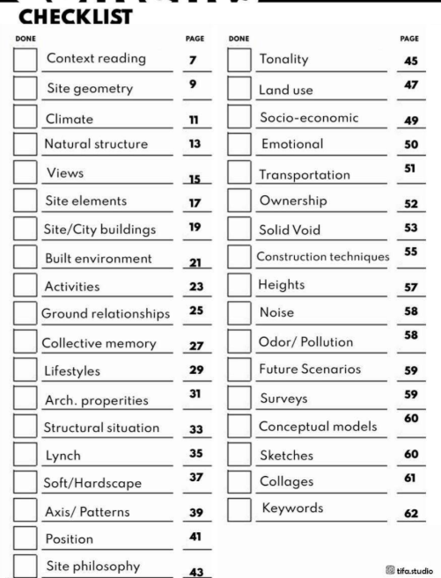
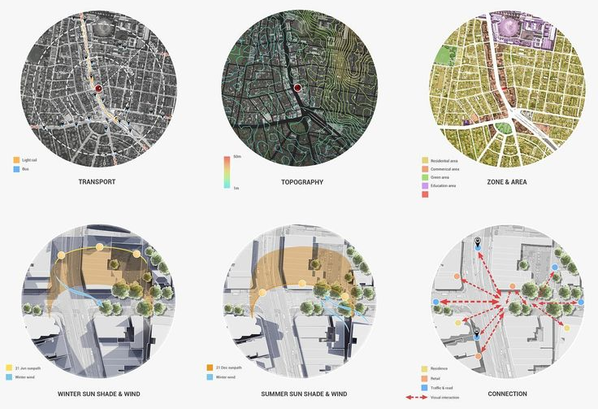
Elements of Site Analysis
Overview of key elements involved in site analysis: topography, climate, context, and legal considerations
Source: ArchDaily

Slide 5
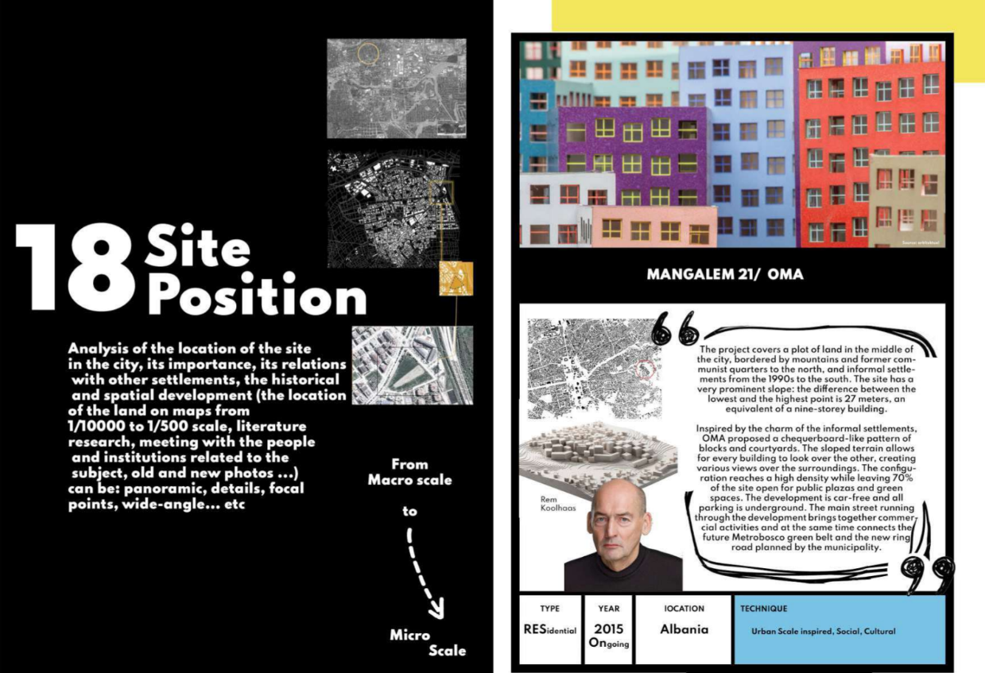
Site Position/Locality
Source: ArchDaily

Slide 6
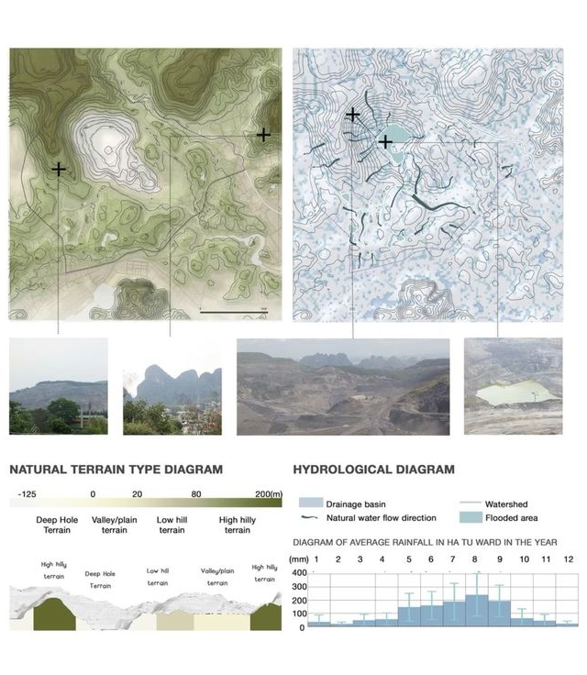
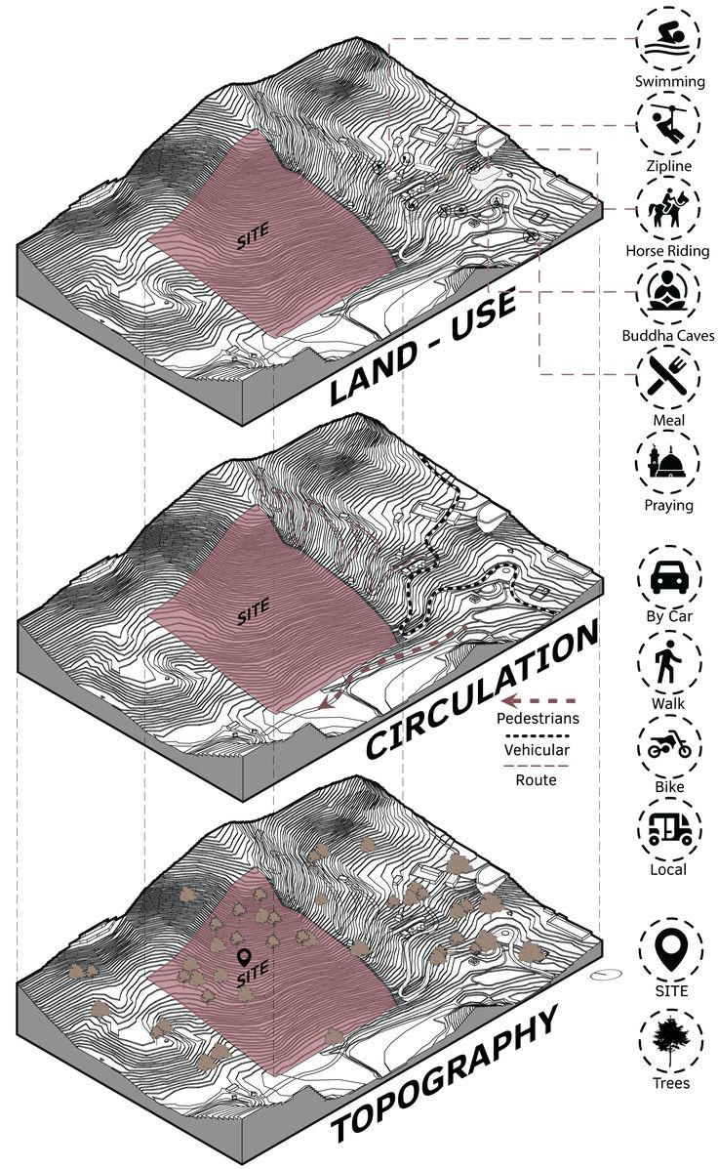
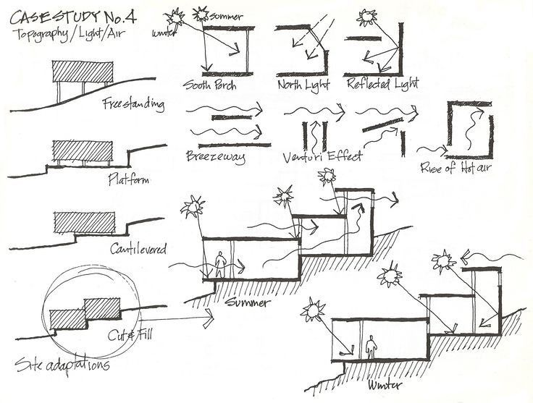
Topography
Examining the physical features of the site, including elevation, slope, and drainage
Source: Pinterest

Slide 7
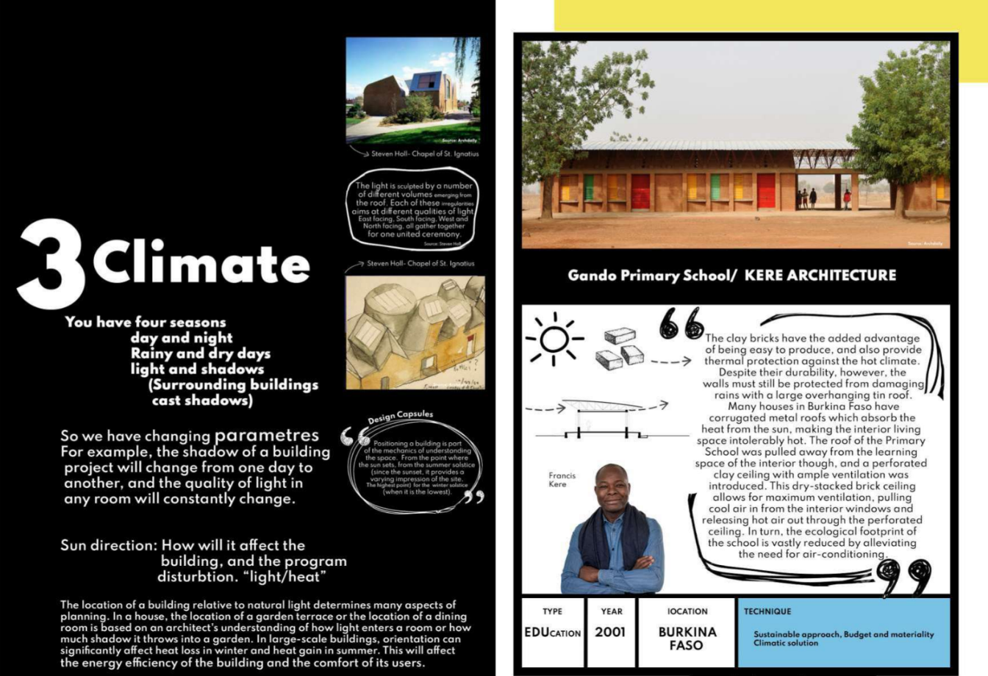
Climate
Assessing climate factors: sunlight, wind patterns, rainfall, and how they influence design
Source: ArchDaily

Slide 8
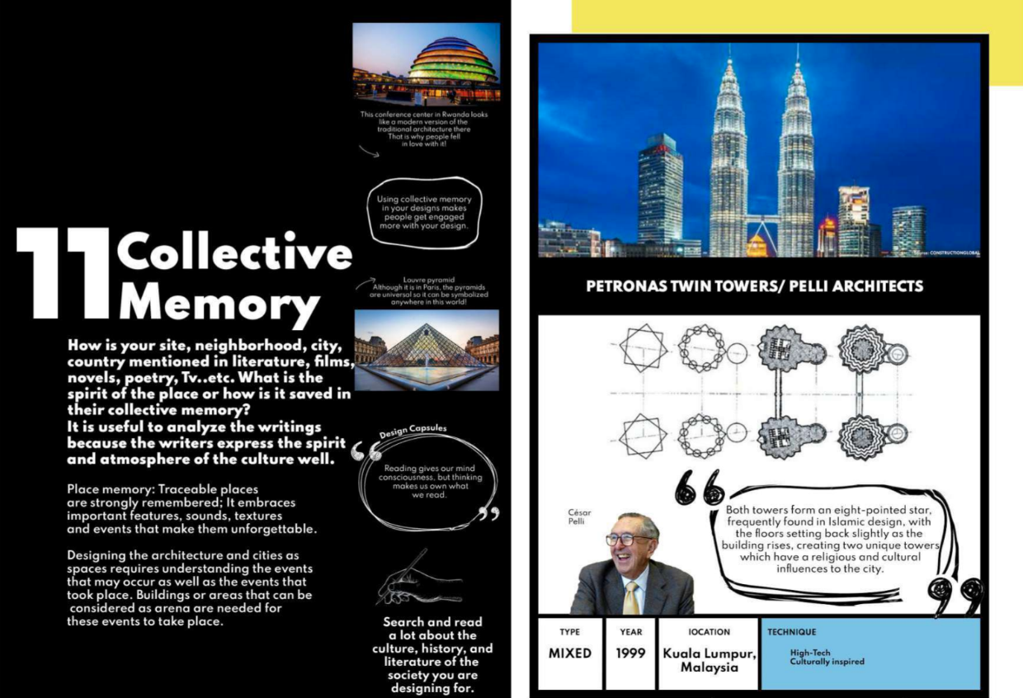
Contextual and Cultural Considerations
Analysing the site’s cultural, historical, and social context and its impact on the design
Source: ArchDaily

Slide 9
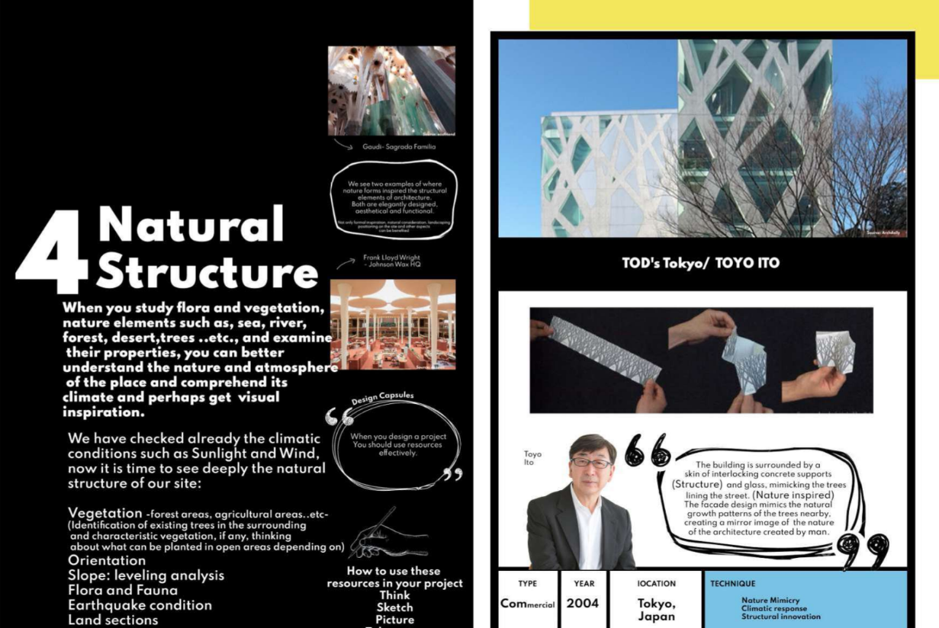
Environmental Impact
Identifying potential environmental impacts and sustainable design opportunities.
Source: ArchDaily

Slide 10
Activity 1: Legal and Regulatory Framework

Slide 11
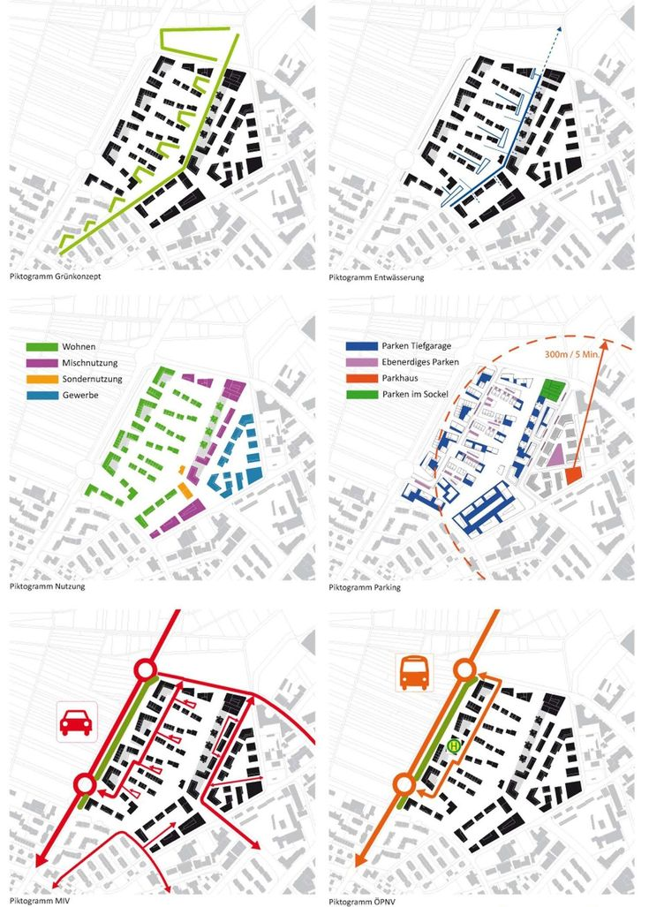
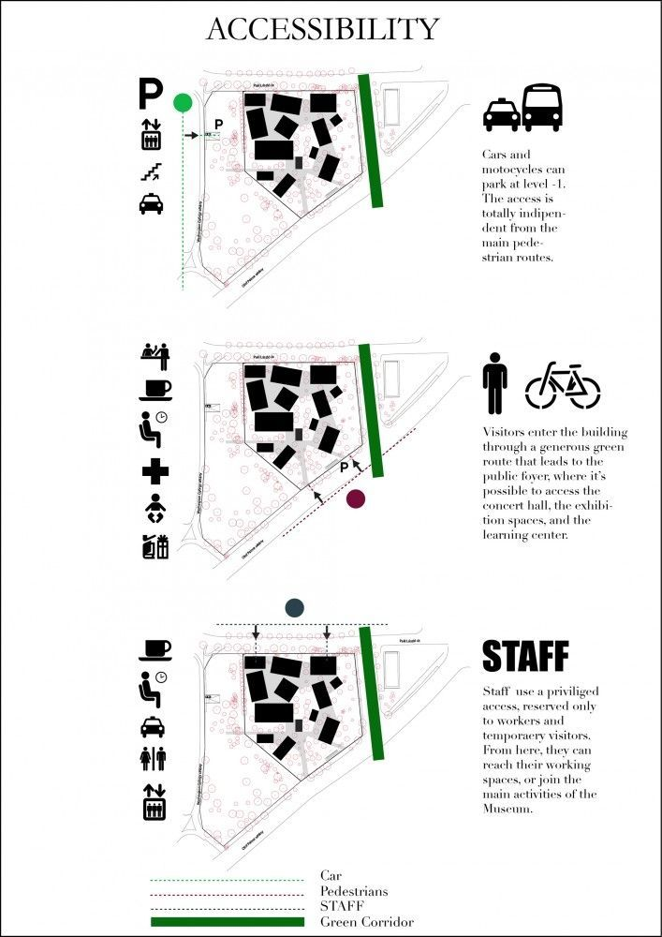
Site Accessibility
Evaluating access to the site for construction and future use, including transportation links and entry points
Source: Pinterest

Slide 12
Tools and Technologies for Site Analysis
Traditional tools:
Surveying Instruments: Transit Level, Theodolite, Tape Measures
Environmental Analysis Tools: Sun Charts and Solar Pathfinders, Wind Vanes, Anemometers
Soil Testing Kits: Soil Composition Testers, pH Level Testers
Documentation Tools: Sketch Pad, Camera
Mapping Tools: Topographic Maps, Site Plans and Zoning Maps
Location Identification Tools: Handheld GPS Devices, Google Map, Site Plan
Other Digital Tools: GIS, BIM, and drone surveys that aid in site analysis.

Slide 13
Activity 2: Site Analysis Visual

Slide 14
Activity 3: Site Analysis Practice

Slide 15
Session 3
Site Plan

Slide 16
Site Plan Introduction
A site plan is a detailed architectural drawing that illustrates the arrangement of buildings and other features on a property. It provides a bird's-eye view of the development that will occur on the site, including the placement of structures, roads, walkways, parking, landscaping, and any existing features that will be retained. The plan also often shows surrounding streets to provide context.
A typical site plan completely describes the site after all construction and adjustments to the site are finished.
A site plan should align with the clients needs, architect’s design ideas, site analysis, zoning and regulation requirements etc…

Slide 17
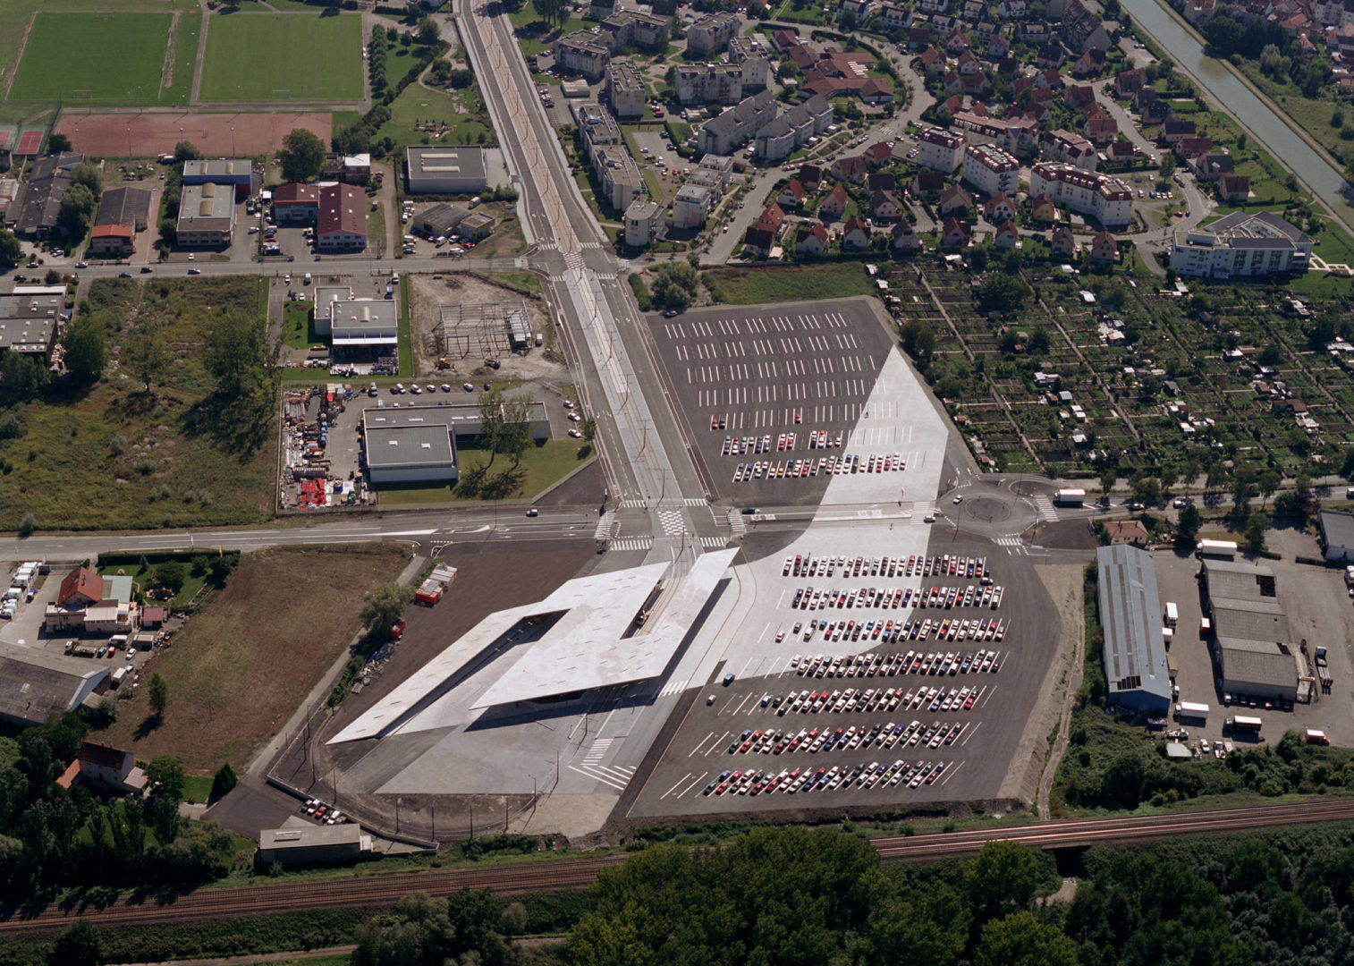
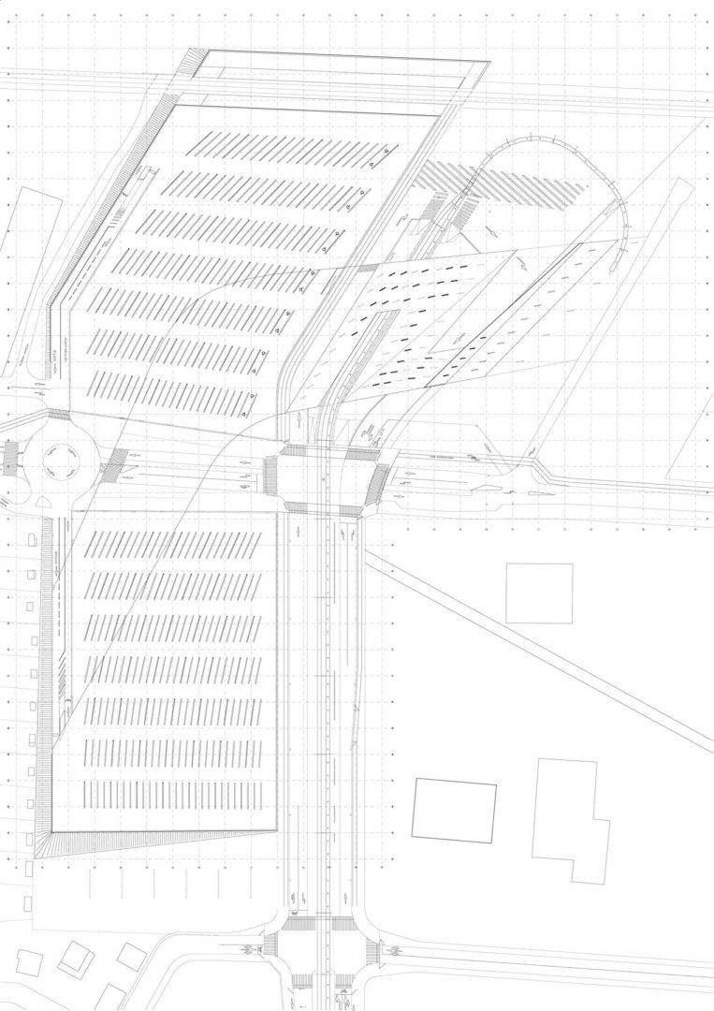
Illustrative Site Plan (no clear measurement/orientation)
Hoenheim-Nord Terminus and Car Park by Zaha Hadid
Source: Zaha Hadid Architects

Slide 18
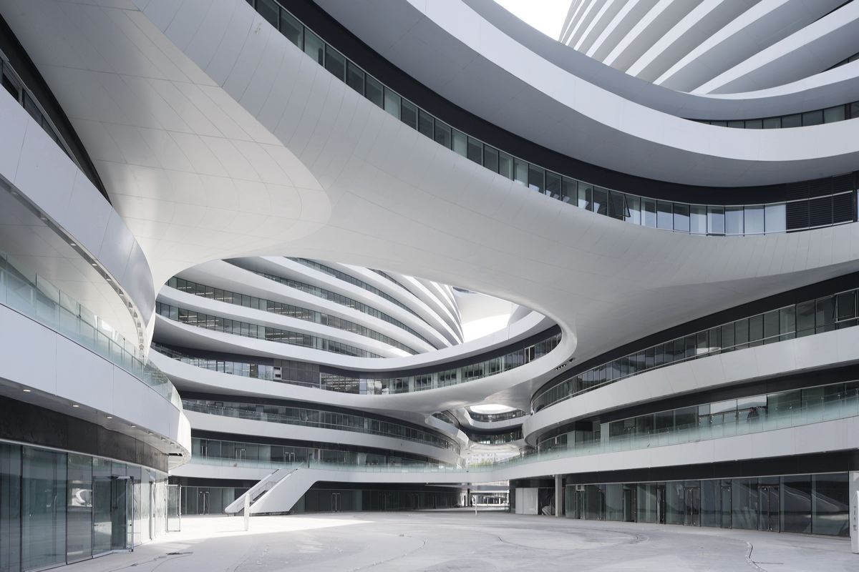
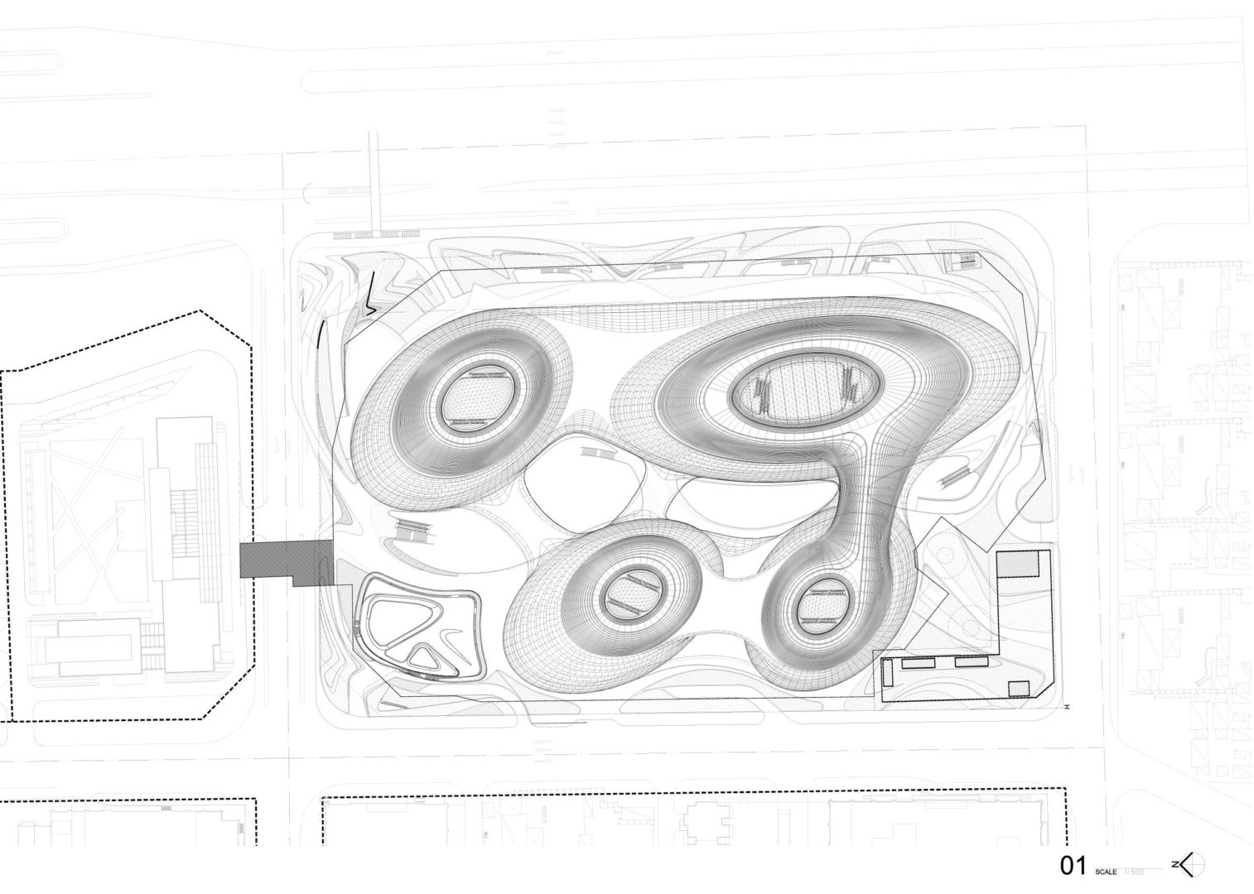
Illustrative Site Plan (no measurement)
Galaxy soho by Zaha Hadid
Source: Zaha Hadid Architects

Slide 19

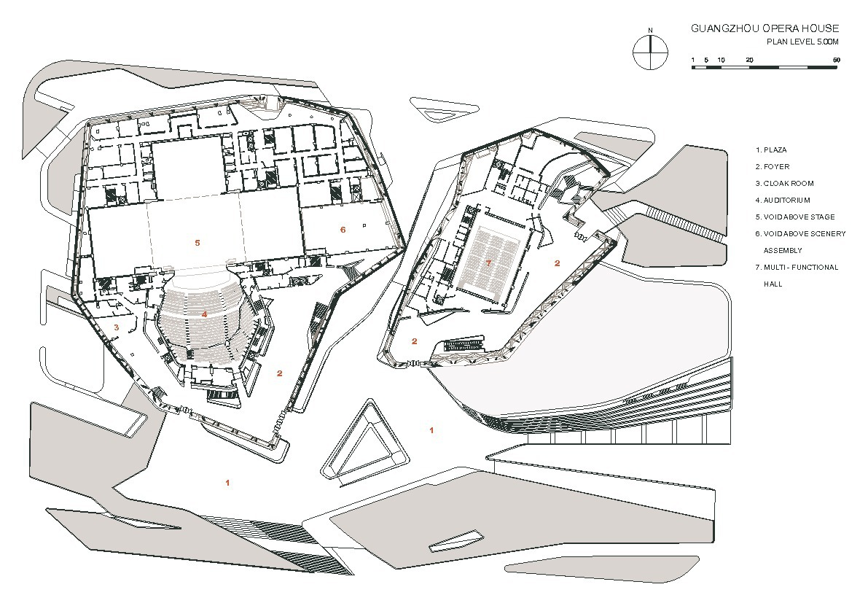
Site Plan and Ground Floor Plan Combined
Guangzhou Opera House
by Zaha Hadid
Source: Zaha Hadid Architects

Slide 20
Site Plan for Permit Application in Victoria
https://www.melbourne.vic.gov.au/applying-planning-permit
Planning permit v.s. Building permit
Steps of planning permit application
Checklist of the application, including drawing types
Use residential development as an example – ResCode (you can find these documents in today’s VUC)
Victoria’s Planning Schemes
ResCode
Planning and Environment Act 1987

Slide 21
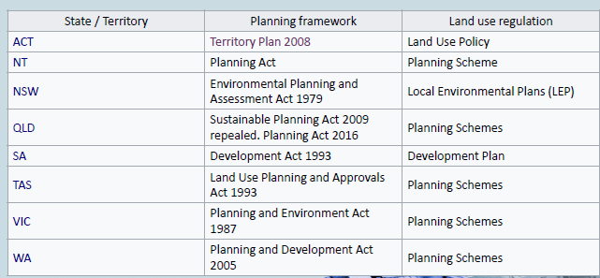
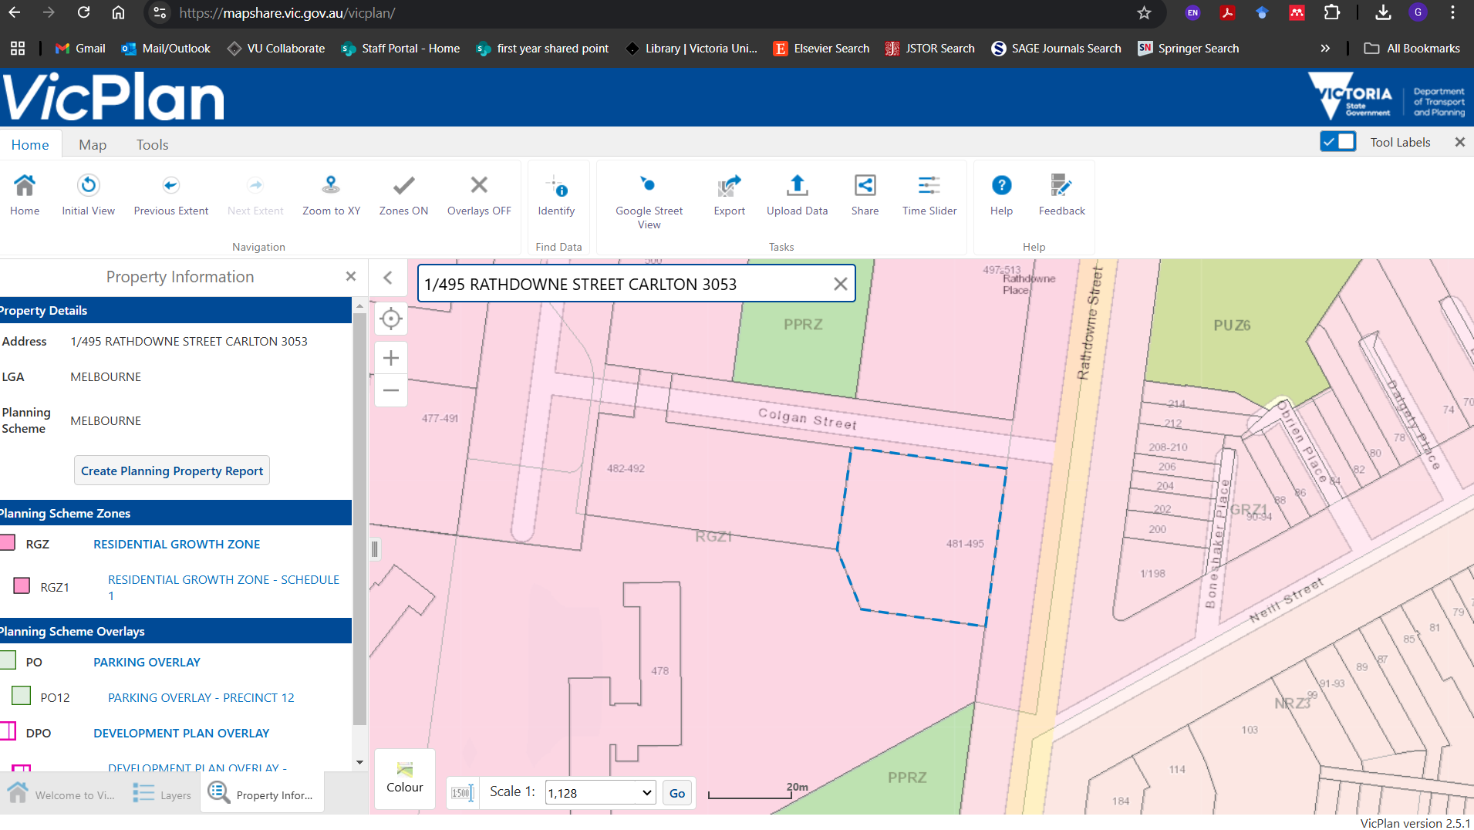
Zoning and Regulatory Compliance
Planning schemes are legal documents that set out policies and provisions for the use, development and protection of land.
Planning schemes refer to a large range of things, including limits for how tall a building can be, as well as ensuring orderly and sustainable use of land.
Refer to Vicplan for specific site zoning and respond to these requirement in the planning permit application as well as the overall design process.

Slide 22
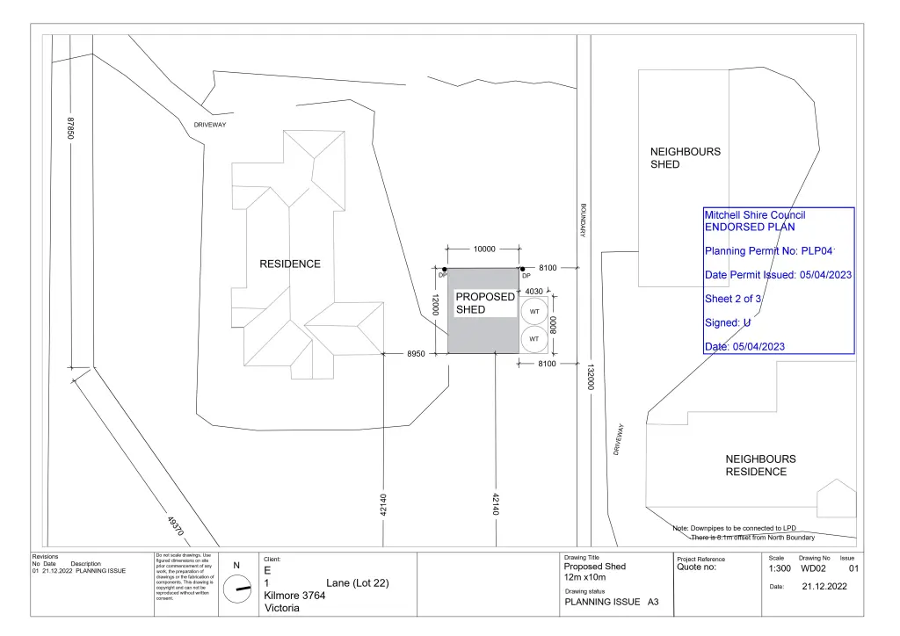
Site Plan for Permit Application
https://www.melbourne.vic.gov.au/applying-planning-permit
Site Plan sample for permit application - displayed on the right: difference between permit site plan and conceptual/illustrative site plan include scale, orientation and details
Source: Planning Practice Notes by Victoria Government

Slide 23
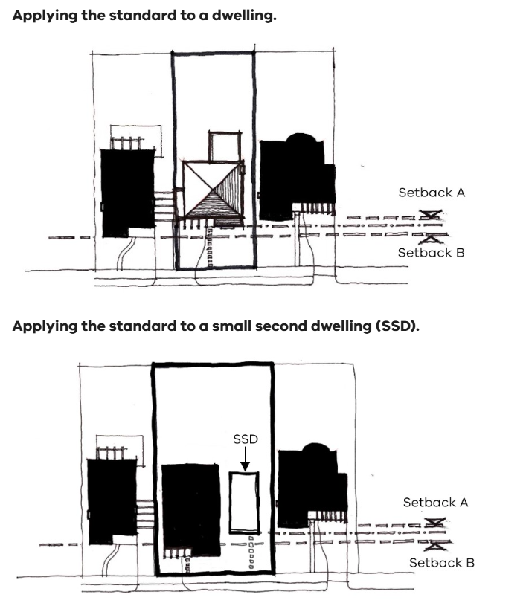
Site Constraints
Setback means
(a) for a building or structure other than a swimming pool, the shortest distance measured horizontally from the outermost projection of the building or structure to the vertical projection of the boundary of the lot.
(b) for a swimming pool, the shortest distance measured horizontally from the water’s edge to the vertical projection of a boundary of the lot.
https://www.planning.vic.gov.au/guides-and-resources/guides/planning-practice-notes/understanding-the-residential-development-provisions
Source: Planning Practice Notes by Victoria Government

Slide 24
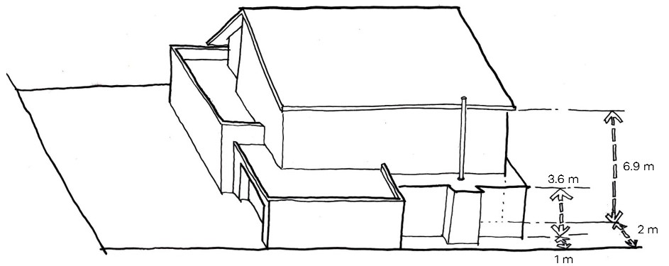
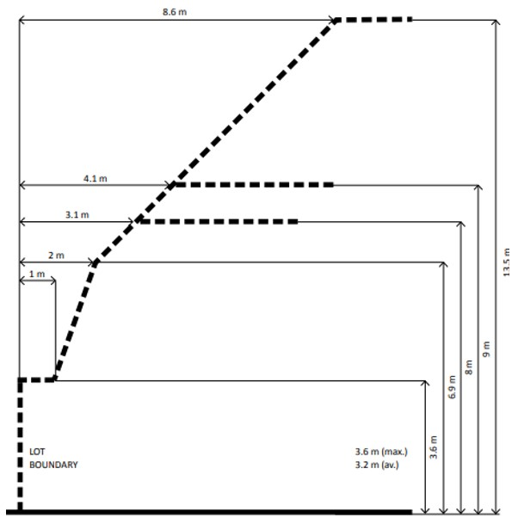
Site Constraints
Building height is an important aspect of both character and amenity in residential areas. The standard protects the amenity of properties near new development and ensures that excessive building height does not diminish the character of neighbourhoods.
Side and rear set back
https://www.planning.vic.gov.au/guides-and-resources/guides/planning-practice-notes/understanding-the-residential-development-provisions
Source: Planning Practice Notes by Victoria Government

Slide 25
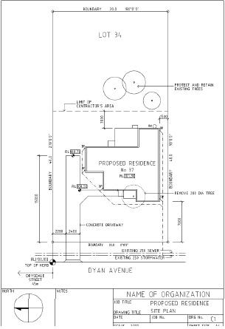
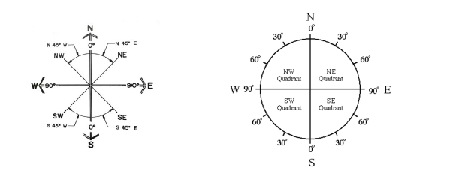
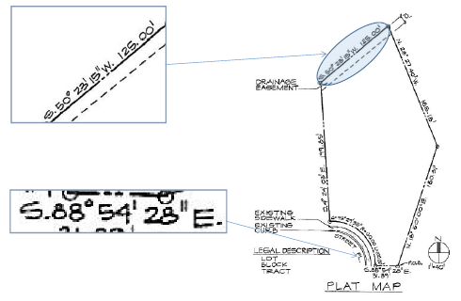
Site Survey
Accuracy is required

Slide 26
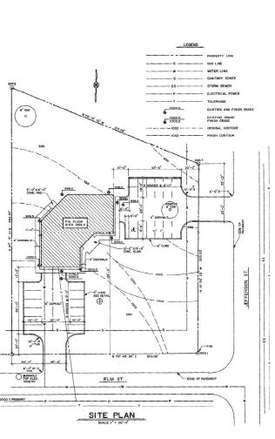
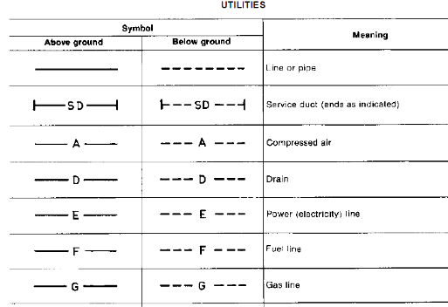
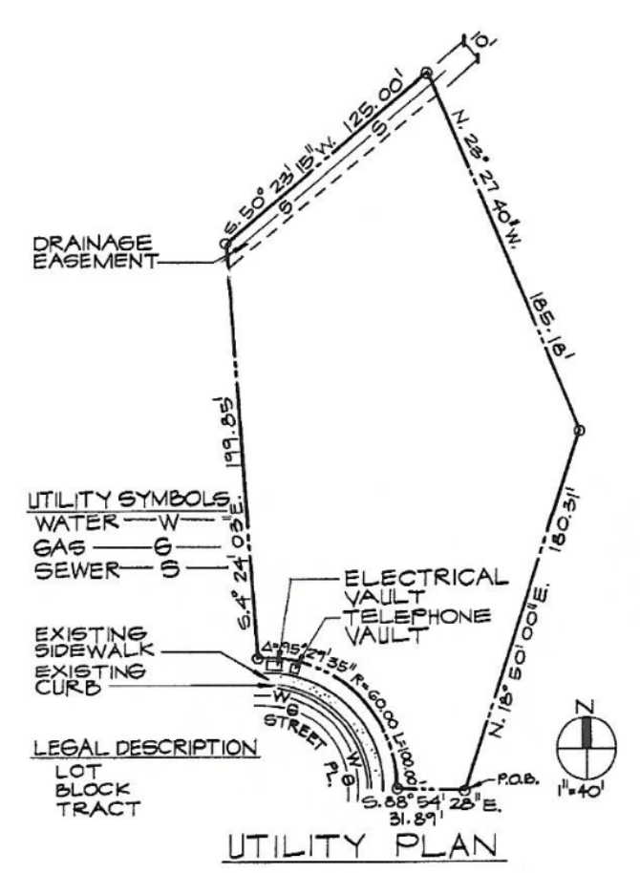
Utilities and Infrastructure
Utility
• The availability of
electricity, gas, sewer,
storm water drain, water,
telephone, etc.

Slide 27
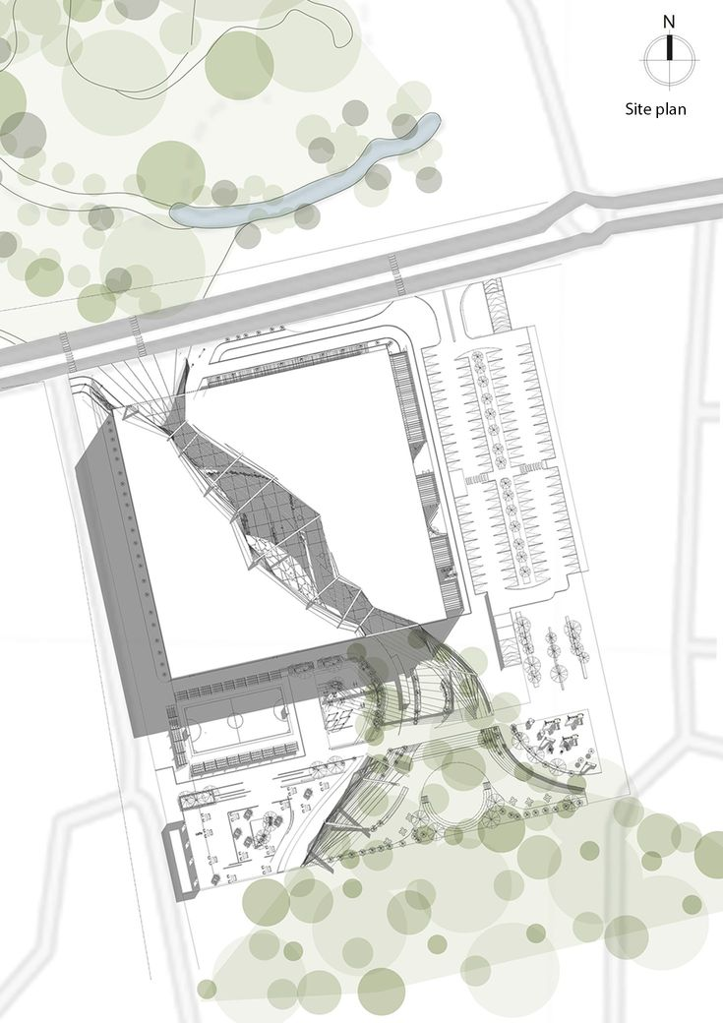
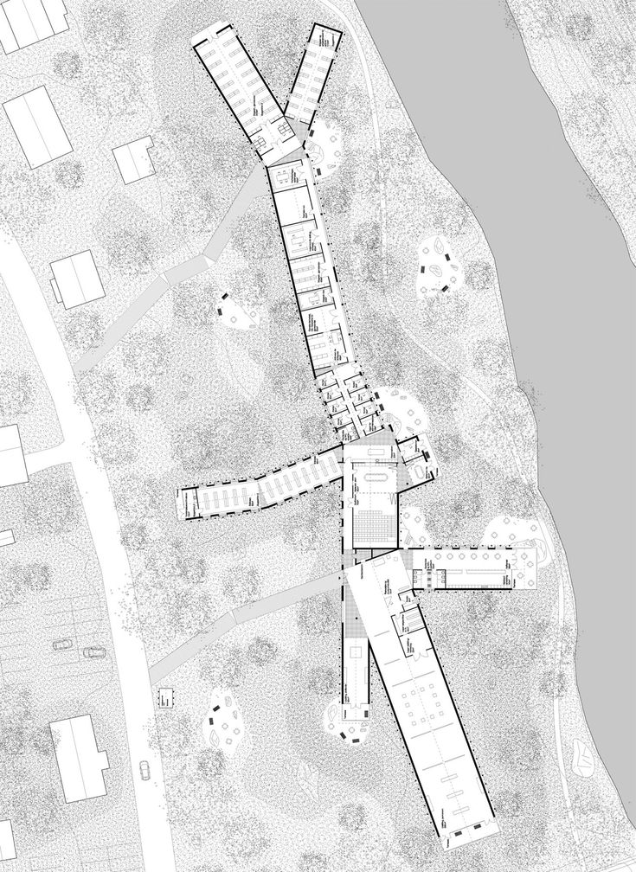
Landscape and Parking
Source: Pinterest

Slide 28
Steps for Site Plan Production
Step 1: research all the regulations and zoning requirement.
Step 2: respond to the clients, project needs and site analysis and produce design drawings. Architects may start with site, massing, concept, floor plan, programming, space, modelling etc …. You will be exposed to a range of design tools in this unit.
Step 3: initial drawing based on the design solutions while satisfy step 1 and 2. Usually, an initial site plan is required to guide the design process. However, the initial site plan can change as design progresses.
Hand sketch v.s. digital (at this early stage of the unit, we ask you to hand sketch your site plan; for the final project, you will learn to use digital tools for site plan production)
Step 4: drawing refinement (you might be going back and forth due to the change of the elevation, floor plan and other design elements) - use pencil first

Slide 29
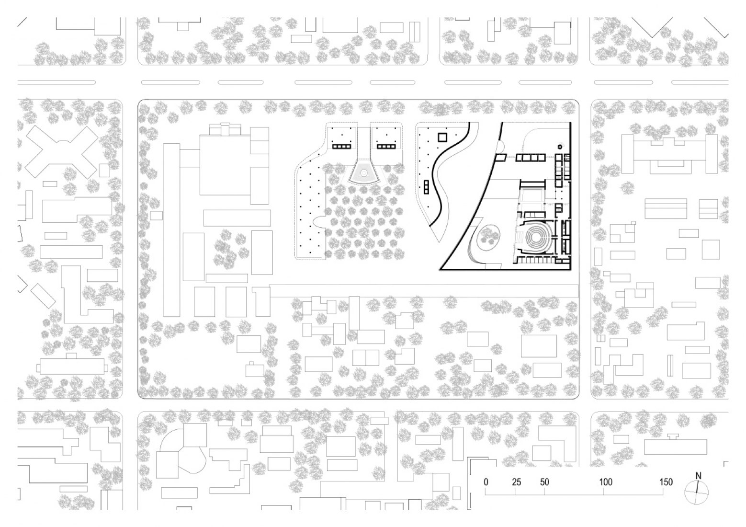
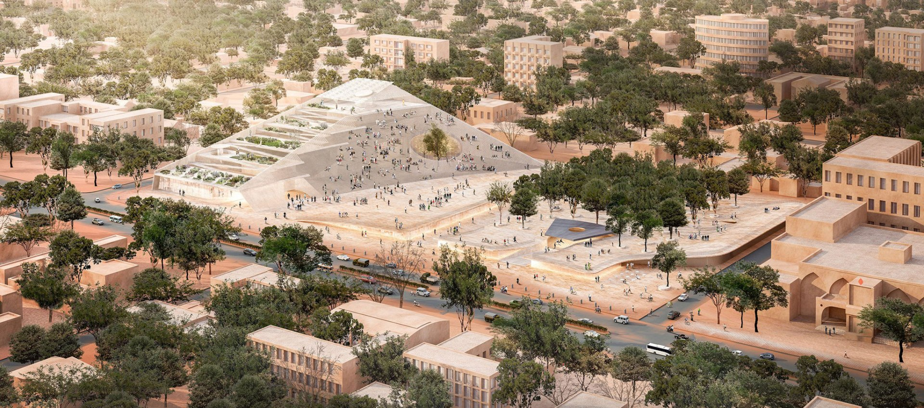
Site Plan Samples from Other Pritzker Award Architects
Burkina Faso National Assembly and Memorial Park
Diébédo Francis Kéré
Source: ArchDaily

Slide 30
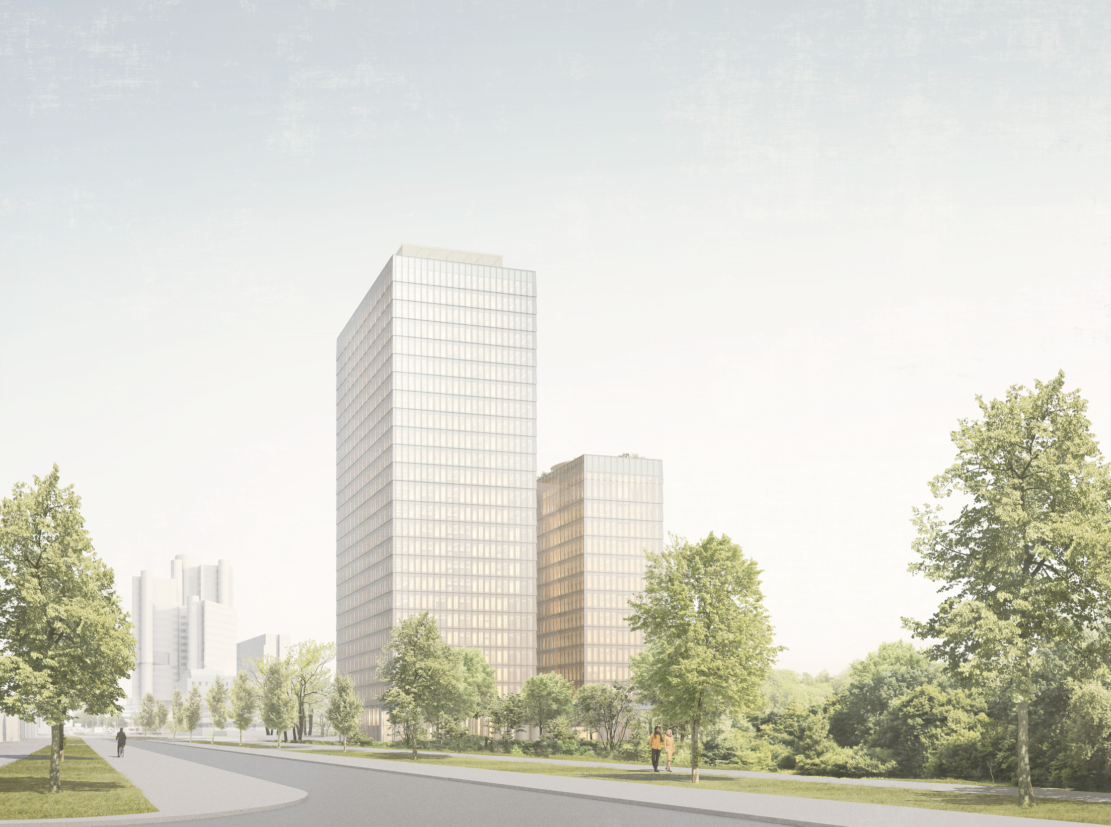
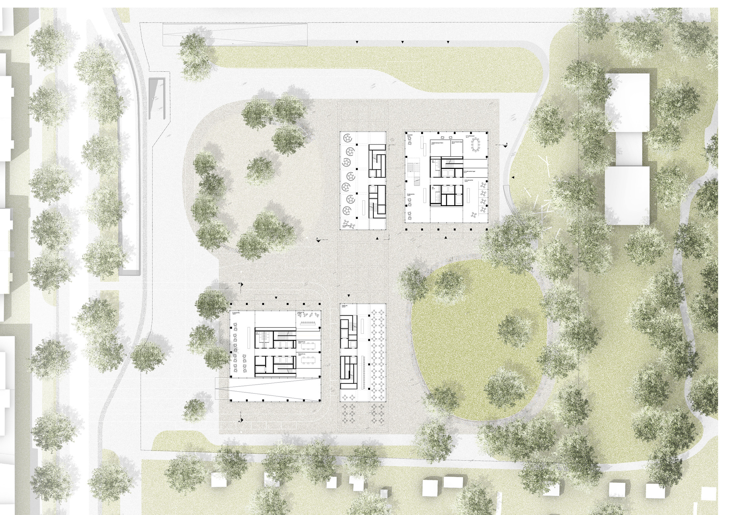
BVK Headquarters
David Chipperfield
Source: ArchDaily

Slide 31
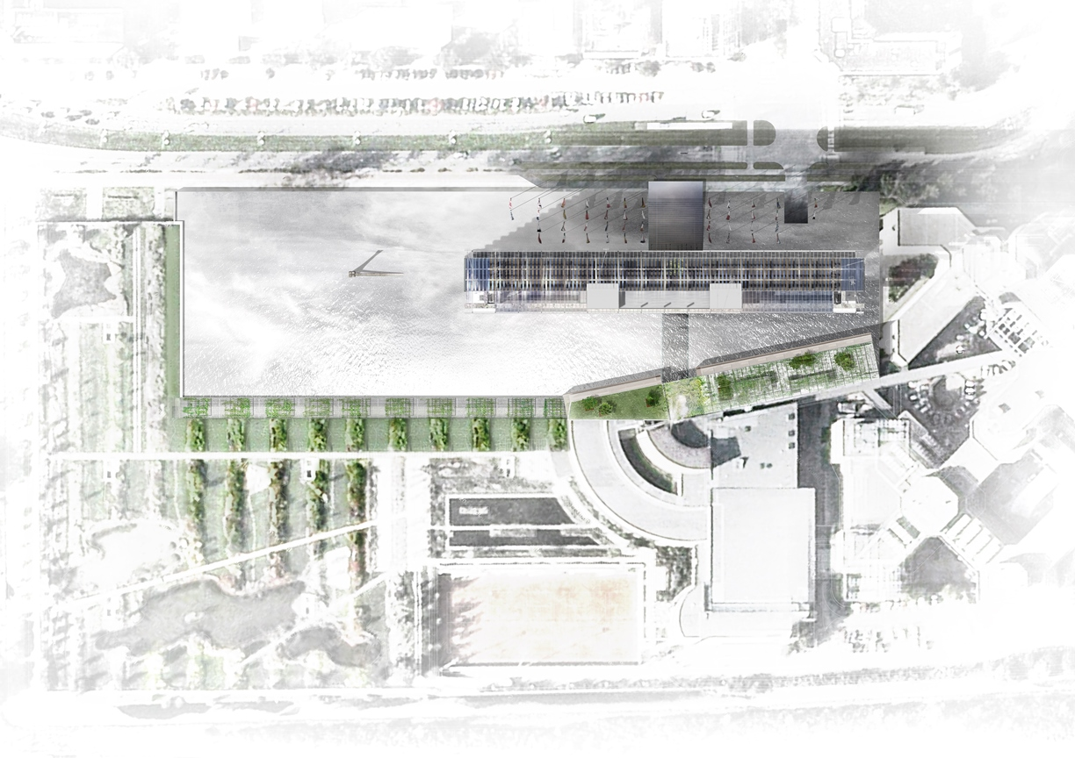
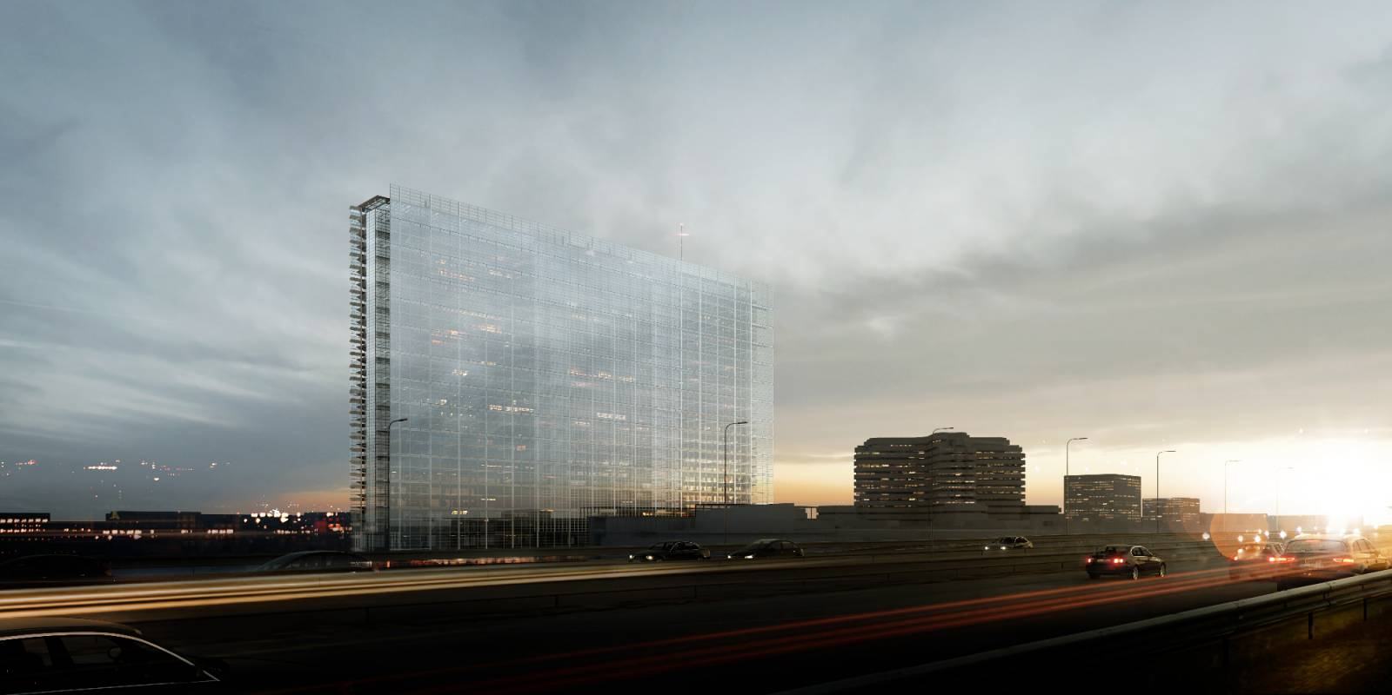
European Patent Office
Jean Nouvel
Source: ArchDaily

Slide 32

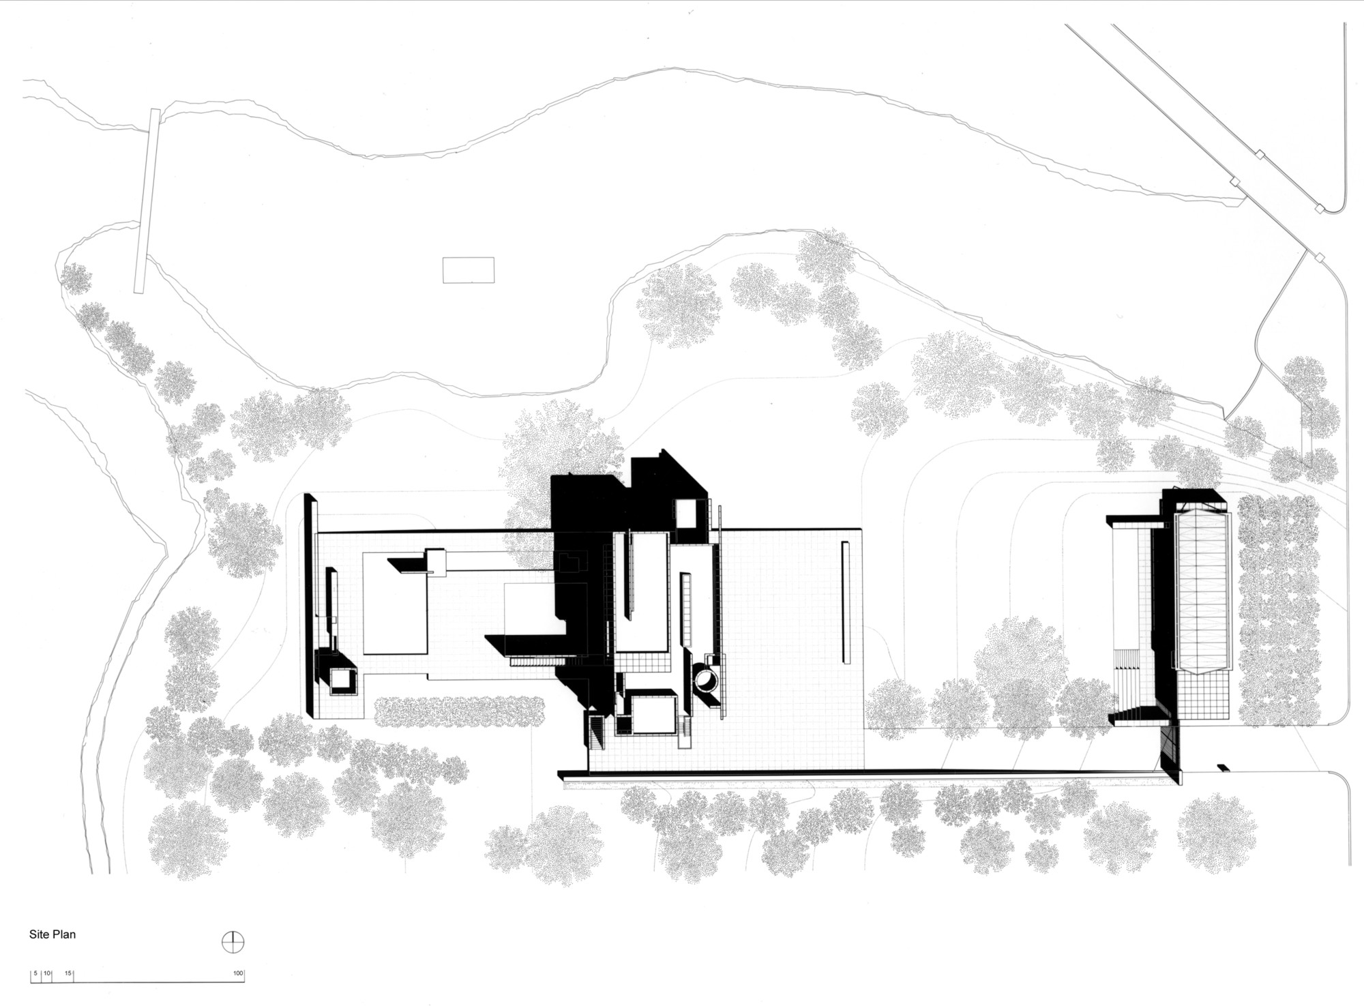
Rachofsky House
Richard Meier
Source: ArchDaily

Slide 33
Activity 4: Site Plan Sketch

Slide 34
References
Arch Daily. (2025). Arch Daily Image. https://www.archdaily.com/
Pinterest. (2025). Pinterest Image. https://www.pinterest.com/
Zaha Hadid Architects. (2025). Zaha Hadid Archives. https://www.zaha-hadid.com/archive/?type=architecture
Department of Transport and Planning. (2025). Planning Practice Notes. https://www.planning.vic.gov.au/guides-and-resources/guides/planning-practice-notes/understanding-the-residential-development-provisions

Slide 35
Thank you
Questions?

